Slide 1
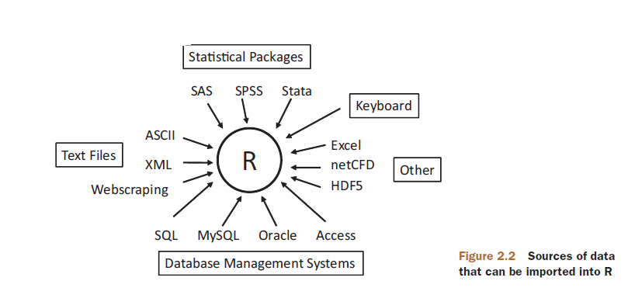
Data Input

Slide 2
User Input
readline()
scan()

Slide 3
User Input: readline()
Default input value is string.
Input values need to be converted if required.
var1 = readline(prompt = "Enter any value : ")
var2 = readline(prompt = "Enter any number : ")
var2 = as.integer(var2)
print(var1)
print(var2)
> print(var1)
[1] "name"
> print(var2)
[1] 12

Slide 4
User Input: readline()
var1 = readline(prompt = "Enter any number : ")
var2 = readline(prompt = "Enter any number : ")
var1 = as.integer(var1)
var2 = as.integer(var2)
print(var1+var2) #output: integer
var = readline("Enter any number : ")
var = as.integer(var)
print(var)
var = readline()
var = as.integer(var)
print(var)

Slide 5
User Input: scan()
This method reads data in the form of a vector or list.
This method can be used to read input from a file as well.
scan() method takes input continuously. Press Enter key twice to terminate the input process.
> x = scan()
1: 1 2 3
4: 7 8 9
7: 7 8 9
10:
Read 9 items
> print(x)
[1] 1 2 3 7 8 9 7 8 9
x = scan()
print(x)

Slide 6
User Input: scan()
d = scan(what = double())
s = scan(what = " ")
c = scan(what = character())
print(d) # double
print(s) # string
print(c) # character
# try absolute path if relative path doesn’t work
s = scan("fileString.txt", what = " ")
print(s) # string

Slide 7
Entering data from the keyboard
The edit() function in R will invoke a text editor that will allow you to enter your data manually.
mydata <- data.frame(age=numeric(0),
gender=character(0), weight=numeric(0))
mydata <- edit(mydata)

Slide 8
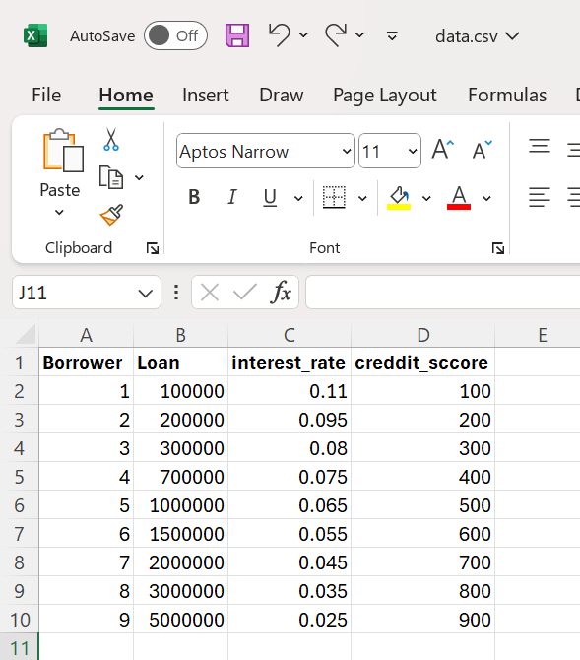
Reading Data from a csv file
In this section, you will read data from a comma-separated values(CSV) file. The csv file format shown below.

Slide 9
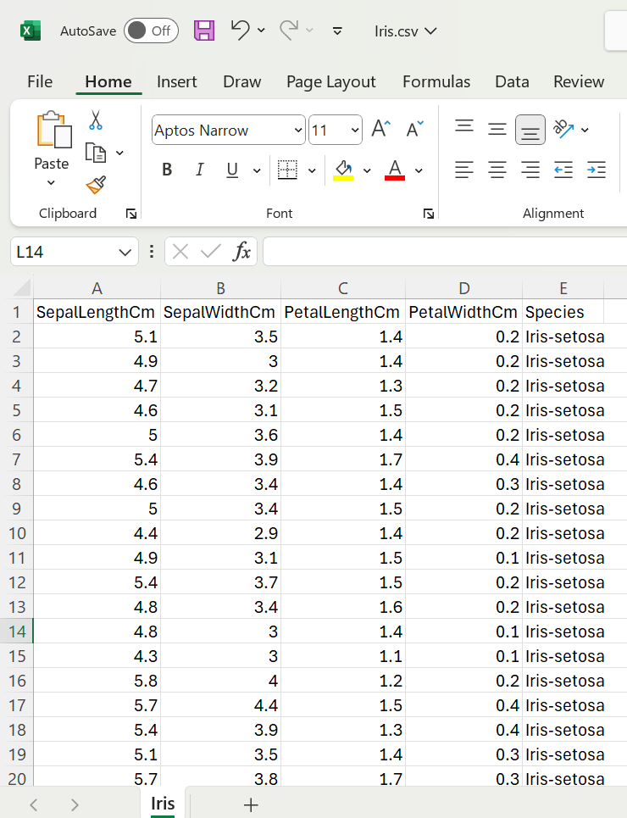
Reading Data from a csv file
In this section, you will read data from a comma-separated values(CSV) file. The csv file format shown below.

Slide 10
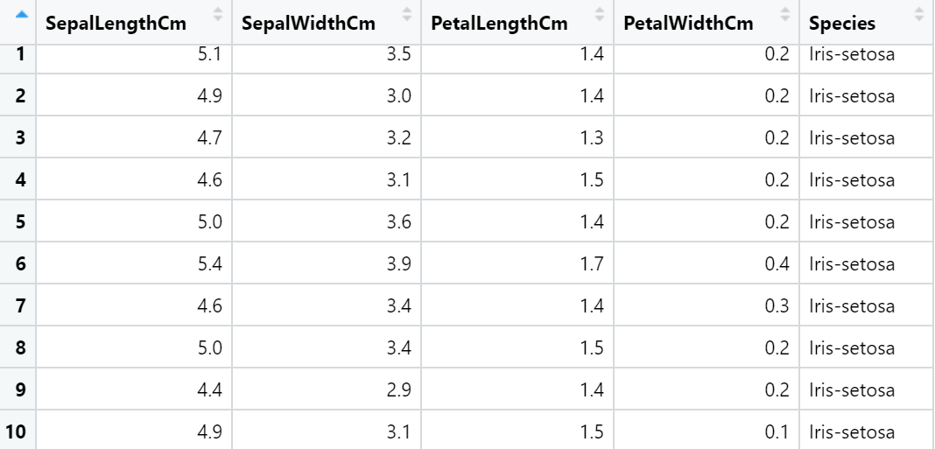
Reading Data from a csv file
mydataframe <- read.csv(file, header=logical_value, sep="delimiter")
mydata<- read.csv("D:/Iris.csv",header = TRUE,sep = ",")
mydata

Slide 11
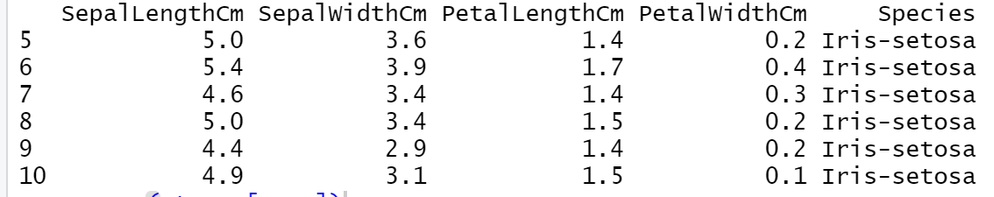
Selecting Data
How to select rows in R for Dataset :
#selecting the 5th to 10th row of the iris dataset.
mydata[5:10,]

Slide 12
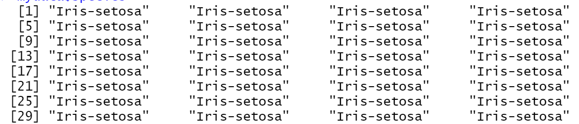
Selecting Data
How to select columns in R
We can select column values in R simply by using the “dataframe name + $ + column name “. In the example below we will be selecting the Species column of the dataset
mydata$Species

Slide 13
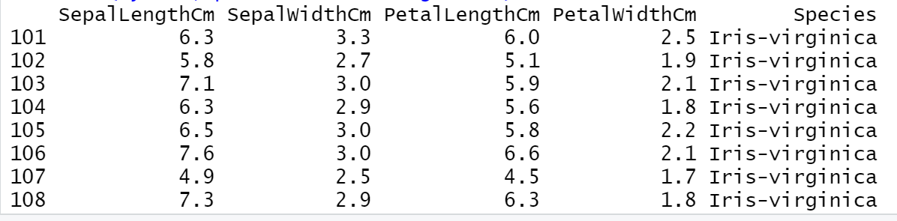
Selecting Data
How to select subset data in R
We can subset data in R using the “subset()” function. We can use this function to subset data based on particular conditions. Let’s say we wanted to view the observations where Species is equal to virginica. We can do this very simply using the code as follows:
subset(mydata,Species=="Iris-virginica")

Slide 14
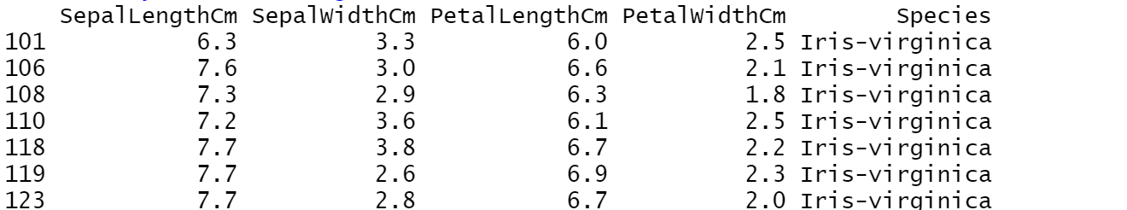
Selecting Data
How to select subset data in R
Now, let’s say we want to view observations that have Petal length greater than or equal to 6. We can do this using the code below.
subset(mydata,PetalLengthCm>=6)

Slide 15
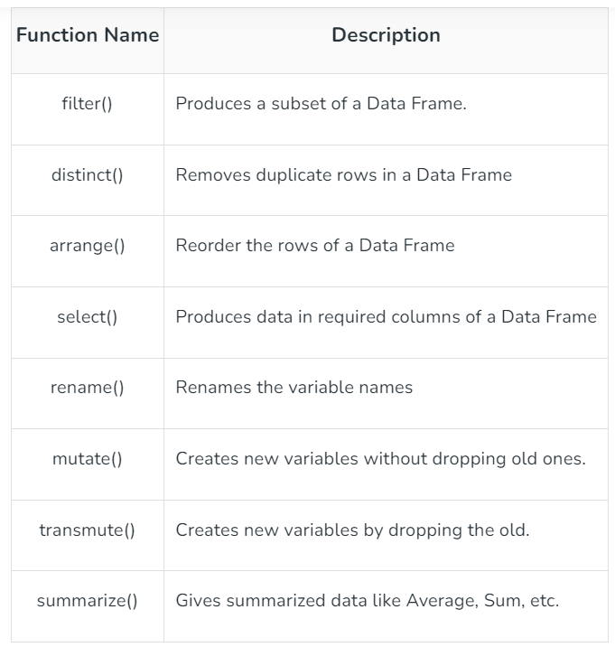
Manipulating Data
To manipulate the data, R provides a library called dplyr which consists of many built-in methods to manipulate the data. So to use the data manipulation function, first need to import the dplyr package using library(dplyr) line of code. Below is the list of a few data manipulation functions present in dplyr package.

Slide 16
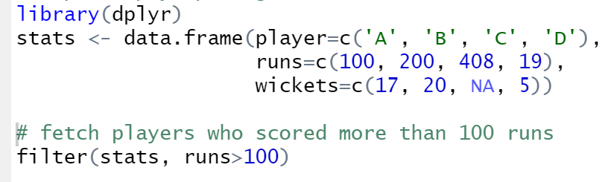
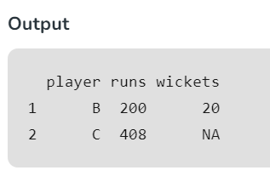
filter() method
The filter() function is used to produce the subset of the data that satisfies the condition specified in the filter() method. In this condition, we can use conditional operators, logical operators, NA values, range operators etc. to filter out data. Syntax of filter() function is given below-
filter(dataframeName, condition)

Slide 17
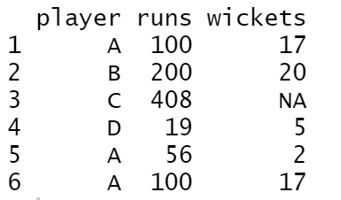
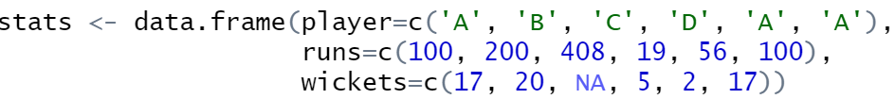
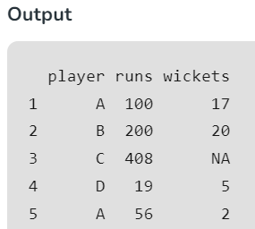

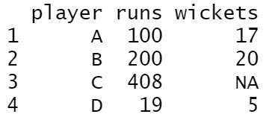

distinct() method
The distinct() method removes duplicate rows from data frame or based on the specified columns. The syntax of distinct() method is given below-
distinct(dataframeName, col1, col2,.., .keep_all=TRUE)

Slide 18
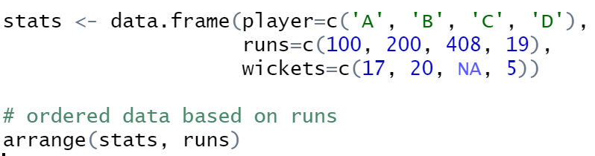
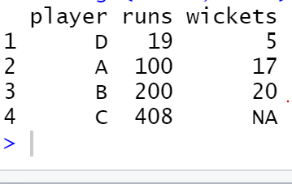
arrange() method
In R, the arrange() method is used to order the rows based on a specified column. The syntax of arrange() method is specified below-
arrange(dataframeName, columnName)

Slide 19
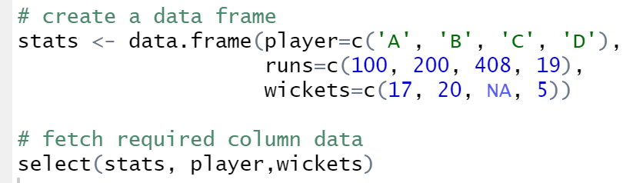
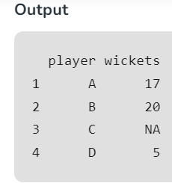
select() method
The select() method is used to extract the required columns as a table by specifying the required column names in select() method. The syntax of select() method is mentioned below-
select(dataframeName, col1,col2,…)

Slide 20
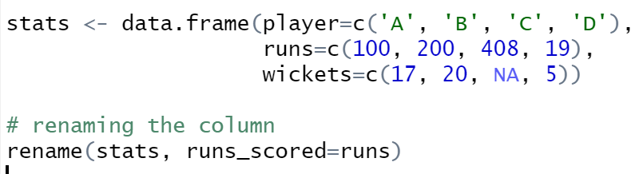
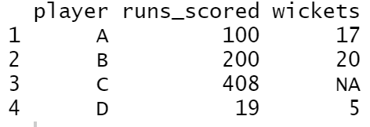
rename() method
The rename() function is used to change the column names. This can be done by the below syntax-
rename(dataframeName, newName=oldName)

Slide 21
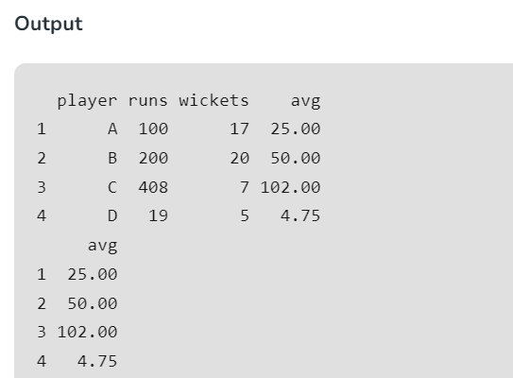
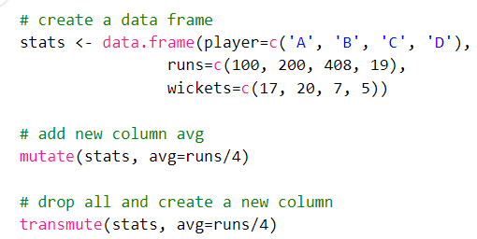
mutate() & transmute() methods
These methods are used to create new variables. The mutate() function creates new variables without dropping the old ones but transmute() function drops the old variables and creates new variables. The syntax of both methods is mentioned below-
mutate(dataframeName, newVariable=formula)
transmute(dataframeName, newVariable=formula)

Slide 22
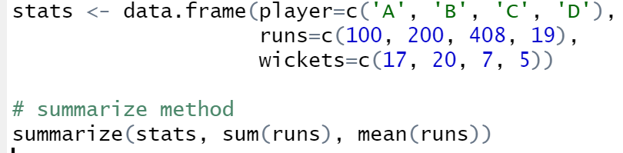
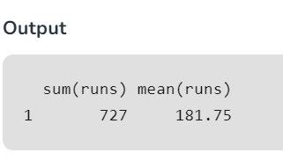
summarize() method
Using the summarize method we can summarize the data in the data frame by using aggregate functions like sum(), mean(), etc. The syntax of summarize() method is specified below-
summarize(dataframeName, aggregate_function(columnName))

